Slide 1
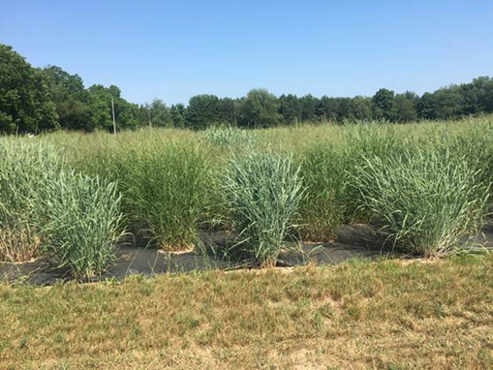
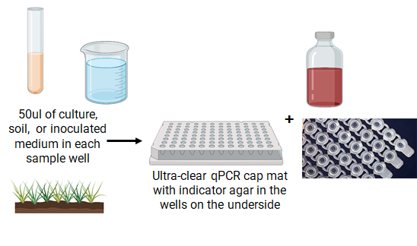
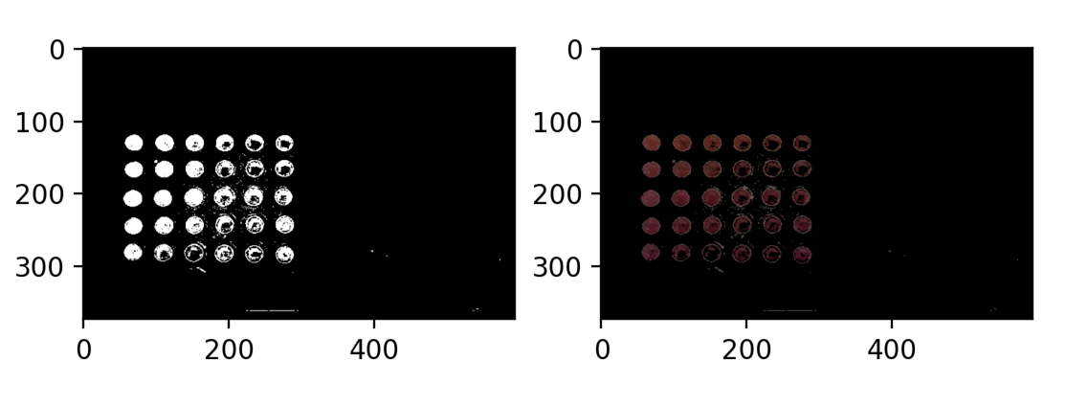
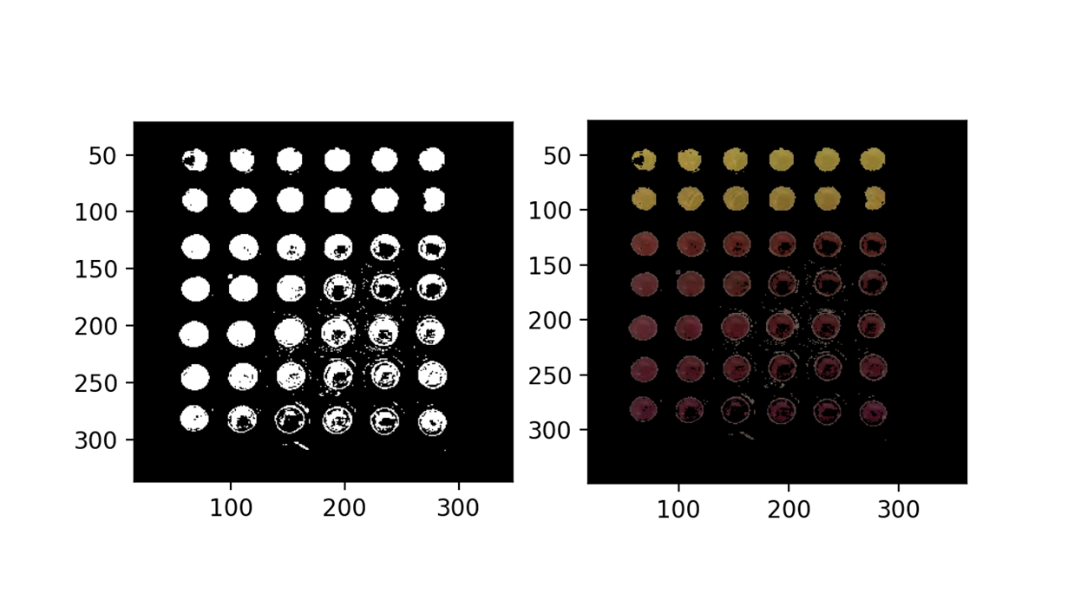
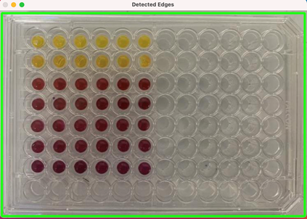
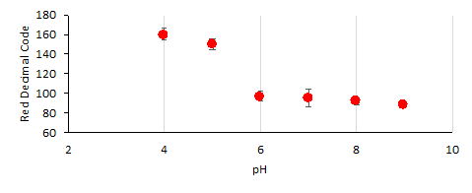
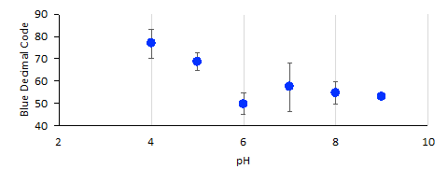
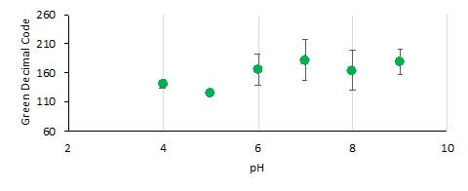
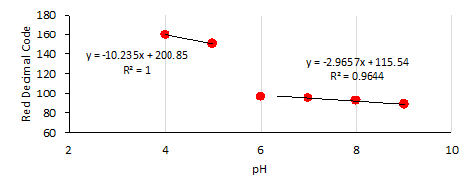
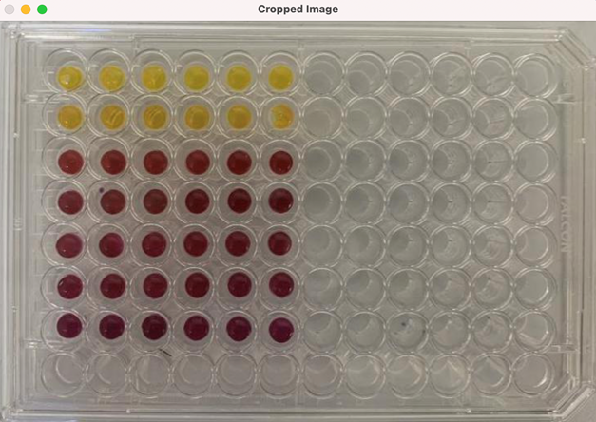
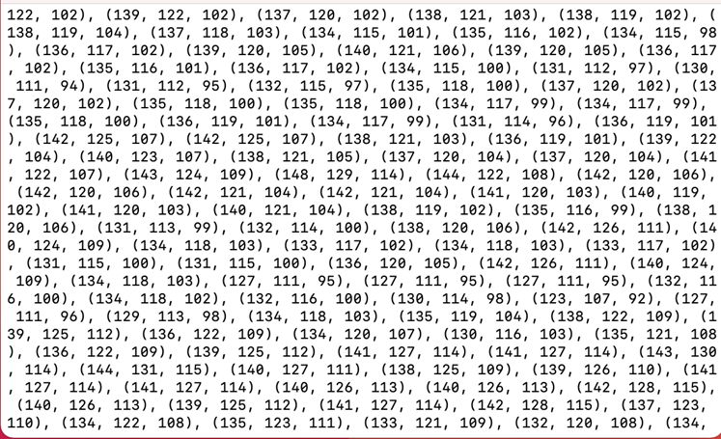
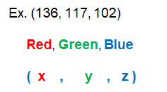
Image Processing for a Point-of-Use Soil Health Assay
Adam Abraham¹, Sara Gushgari-Doyle², Romy Chakraborty²
¹Los Angeles Pierce College, Woodland Hills CA
²Ecology Department of Lawrence Berkeley National Laboratory, Berkeley CA
2021 Transfer-to-Excellence Research Experiences for Undergraduates Program (TTE REU Program)
Abstract
This research provides real-time monitoring of soil health through the improvement of in-field soil health assays. This is accomplished through analyzing colorimetric assays that use pH cresol red to measure the CO₂ produced by microbial respiration from prospective soil samples in PCR tubes. We are building an iOS application that processes assay images, analyzes the data, and gives informative feedback on soil health, making it accessible to all via smartphone.
Introduction
Results
With population rates increasing and growing demands to provide food and energy crops to more people in sustainable ways, soil health has become a priority in solving these challenges
3D Scatter Plot of RGB Pixel Decimal Values
We propose a solution with an inexpensive kit that measures soil health effectively
Yellow Mask
Red Mask
Methods: Object Detection
+
Blur function and cv2.Canny function used to expose contour lines from image
Sample Image Processed: Both Masks Combined
Sample Image
Blurred Image with Contours
Well Plate Detected
cv2.Rectangle function used to detect edges of well plate
Standard Curves for RGB Channels
Methods: Accessing Image Pixel Arrays / Data
A function was used to view and access image pixel arrays and data
This was done to find locations of color pixels
Best Proxy
Cropped and Resized Image
Pixel Arrays and Data Exposed
Future Work
Test more 96-well plate images to increase accuracy in image processing and the standard curve.
Future plates tested will include more values between pH 5 and 6 (e.g. 5.2, 5.4) to create an accurate standard curve between these values.
Acknowledgments
The authors would like to thank Nicole McIntyre, Tony Vo Hoang, Sam Mountain, and the E³S staff for facilitating the TTE REU 2021 program and for their constant support. This research was funded by the National Science Foundation Award #1757690.
Contact Information
Adam Abraham
Phone: (818) 257-5626
Email: adamabraham14@berkeley.edu

