Slide 1


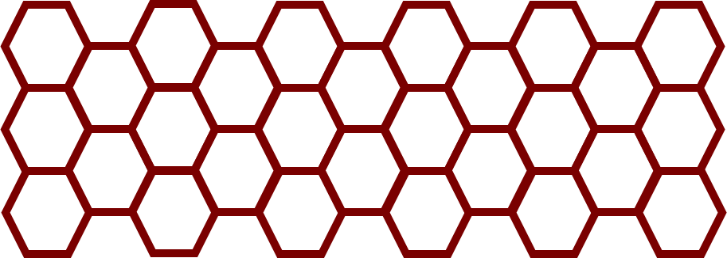
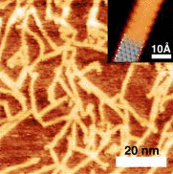
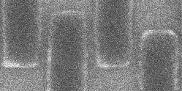

Understanding the Raman Spectra of Graphene Nanoribbons for Device Fabrication
Wyatt Jebef^{1,2}, Zafer Mutlu², and Jeffrey Bokor²
¹Santa Barbara City College, ²EECS Department, University of California, Berkeley
2020 Transfer-to-Excellence Research Experiences for Undergraduates Program (TTE REU Program)
Abstract
Graphene nanoribbons (GNRs) are quasi-one-dimensional carbon-based semiconductors that possess a tunable bandgap contingent on ribbon width and edge topology and are therefore a promising alternative for silicon channels in future transistors. The bottom-up synthesis of GNRs provides ultimate control over ribbon design and thus their electronic properties. STM and Raman spectroscopy are the two standard techniques used for characterizing bottom-up synthesized GNRs. Although STM is an effective method to obtain atomic-scale information, its scope is localized and is limited to GNR samples grown on metallic substrates. Contrastingly, Raman spectroscopy is a fast and non-invasive analytical approach that provides complementary information about GNRs on both metallic and insulating substrates at a macroscopic scale. However, most contemporary studies only use Raman spectroscopy to identify GNR type. Herein, we investigate the effect of growth substrates, doping and the transfer process on the Raman features of seven-atom wide armchair GNRs (7-AGNRs) in order to advance their large-scale characterization and implementation in transistors.
Motivation
Results
Bottom-up synthesis enables GNR bandgap engineering via molecular precursor design and produces uniform GNRs that can serve as key elements for post-silicon CMOS devices.[1]
Project goal: Increase current understanding of GNR Raman modes to advance the large-scale ex-situ characterization of GNRs and improve device fabrication techniques.
Long-term goal: Implement GNRs in high-performance transistors.
Growth on metallic substrates
Changes in G mode frequency and I_{D}/I_{G} ratio indicate GNR band structure modification via substrate effects – both electronic interactions and strain induced by lattice mismatch.
Armchair
V_{D}
Electrode
GNR
Doping with HCl and KI₂
Chiral
1
2
3
N
Dielectric
Zigzag
Gate
V_{G}
GNR-based field-effect transistor (FET) model.
Three GNR edge designs – armchair, chiral and zigzag.
Inverse relationship of armchair GNR width and bandgap.[2]
G shift trend again indicates change in GNR electronic structure.
Increase in the D peak linewidth and I_{D}/I_{G} ratio indicates KI₂ is damaging GNRs.
Methods
Transfer to insulating substrates
DBBA
Bottom-up synthesis [1]
Polymer chain
7-AGNR
Deposition on Au(111) + heating
Polymerization + planarization heating
Cyclodehydrogenation
KI₂ is one of the primary causes of defects induced during wet-transfer to SiO₂/Si.
STM image of 7-AGNRs.[3]
Conclusion
Transfer method and device fabrication
Raman spectroscopy has applications beyond GNR type identification.
Alternative transfer methods or etchants should be explored to reduce defects induced during transport to insulating substrates.
With further research, we hope to confirm the trends noted in this work so that the G and D Raman modes may be used to probe changes in GNR band structure caused by doping and lattice strain.
GNRs
Target
Pd
GNRs
V_{D}
Au(111)
References
Mica
SiO₂
W
HfO₂
HCl
Gold etchant
Si
V_{G}
[1] Cai, J. et al., “Atomically precise bottom-up fabrication of graphene nanoribbons.” Nature (2010).
[2] Yang, L. et. al., “Quasiparticle Energies and Band Gaps in Graphene Nanoribbons.” Phys. Rev. Lett. (2007).
[3] Bennett, P. et al., “Bottom-up graphene nanoribbon field-effect transistors.” Appl. Phys. Lett. (2013).
[4] Llinas, J. et al., “Short-channel field-effect transistors with 9-atom and 13-atom wide graphene nanoribbons.” Nature Communications (2017).
[5] B. V. Senkovskiy et al., “Making Graphene Nanoribbons Photoluminescent.” Nano Lett. (2017).
[6] H. Huang et al., “Spatially Resolved Electronic Structures of Atomically Precise Armchair Graphene Nanoribbons.” Scientific Reports, (2012).
Wet-transfer [3],[4]
Finished device
Raman spectroscopy and STM characterization
Acknowledgements
Microscopic lens
Laser
7-AGNRs on Au(111)
I would like to thank the following people: Nicole McIntyre and Sam Mountain for their exceptional administrative support, Dr. Zafer Mutlu for his invaluable mentorship and guidance, and Professor Jeffrey Bokor for allowing me to conduct this research as a remote member of the Bokor lab group. I would also like to acknowledge the Center for Energy Efficient Electronics Science as well as the National Science Foundation for funding this project. Raman spectroscopy was performed at the Molecular Foundry at Lawrence Berkeley National Laboratory (LBNL), supported by the Office of Science, Office of Basic Energy Sciences, of the U.S. Department of Energy (DOE) under contract No. DE-AC02-05CH11231. Device fabrication was performed at the Stanford Nano Shared Facilities (SNSF) at Stanford University.
Sample
Notch filter
100 nm
CCD
STM image of Pd electrodes from GNR-based FET.
Contact Information
Wyatt Jebef
Email: wyattjebef@gmail.com
Support Information
This work was funded by National Science Foundation Award ECCS-0939514
& ECCS-1461157
Spectroscopic grate

