Slide 1
Low Energy Electronics:
DARPA Portfolio
Dr. Michael Fritze
DARPA/MTO
1st Berkeley Symposium on Energy Efficient Electronics Systems
June 11-12, 2009

Slide 2



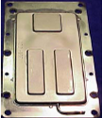
Power Efficient Electronics Are Critical
to Many DoD Missions
Soldiers carry packs in 70-120lb range
Frequently 10-20 lbs are batteries!
Power is frequently scarce and expensive: UAVs, remote sensor networks, space, etc.
Dragon Eye
110-200W
Battery Weight 0.7Kg
Getting rid of dissipated heat
is often a major problem by itself!
Heat Pipe

Slide 3
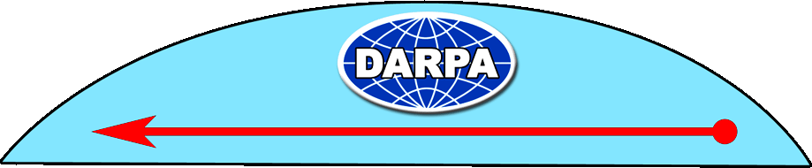
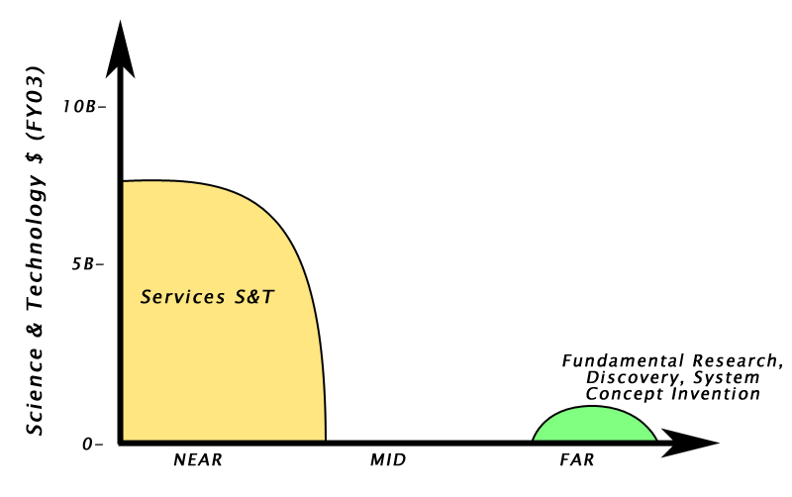
DARPA Role in
Science and Technology

Slide 4
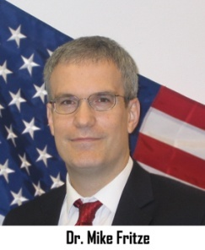
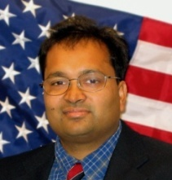
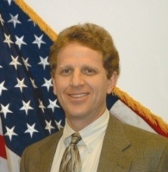
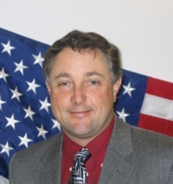
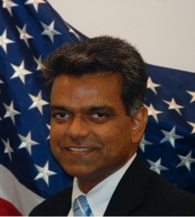

DARPA Role in
Science and Technology
DARPA PMs work to
“Fill the Gap” with programs
Fritze
Lal Rosker
Harrod
Kenny
Shenoy

Slide 5


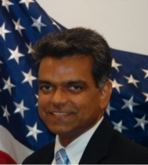

DARPA Low Power Electronics
Device Thrust (Fritze, Lal, Shenoy)
STEEP, NEMS, CERA, STT-RAM, “ULP-NVM”
Circuits Thrust (Fritze)
3DIC, “ULP-Sub-V_{T}”, “HiBESST”
Thermal Management Thrust (Kenny)
TGP, MACE, NTI, ACM
“THREADS” (Rosker/Albrecht)
High Performance Computing Thrust (Harrod)
PCA, “EXASCALE”
Programs in BOLD are currently running

Slide 6
Device Thrust:
New Transistor Technology
Electronics History: Power Perspective
Each technology ultimately reaches integration density limited by power dissipation
Quantum jump then occurs to new technology with lower power
It is time for the next paradigm change in transistor technology !

Slide 7

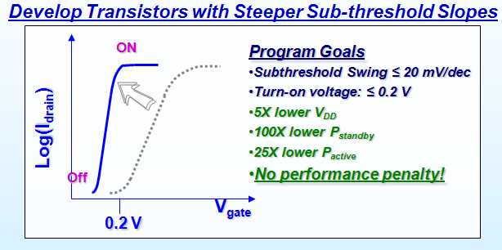
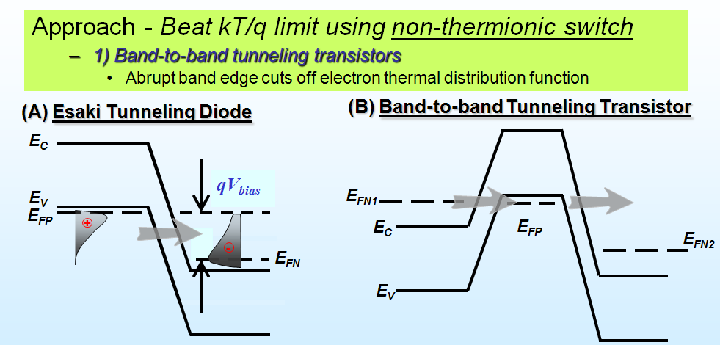
Steep-subthreshold-slope Transistors for
Electronics with Extremely-low Power (STEEP)
GOAL: Realize STEEP slopes
(<< 60 mV/dec) in silicon technology
Platform (Si & SiGe)
PERFORMERS: IBM, UCB, UCLA
APPROACH: BTB Tunneling FETs
“Properly” designed p-i-n device
CHALLENGES:
Abrupt doping profiles !

Slide 8
Hybrid NEMtronics (Lal)
Objectives
Eliminate leakage power in electronics to enable longer battery life and lower power required for computing.
Enable high temperature computing for Carnot efficient computers and eliminate need for cooling
Approaches
Use NEMS switches with and without transistors to reduce leakage – I_{on}:Transistor, I_{off}: NEMS
NEMS can work at high temperature, enabling high efficiency power scavenging.
I_{off}
1
1
I_{on}
0
1
0
1
0
0
All Mechanical Computing
Hybrid NEMS/CMOS component integration
GND
IN
IN
VDD
OUT
N+
N+
P+
P+
P-Substrate
N-Well
Hybrid NEMS/CMOS Device integration

Slide 9
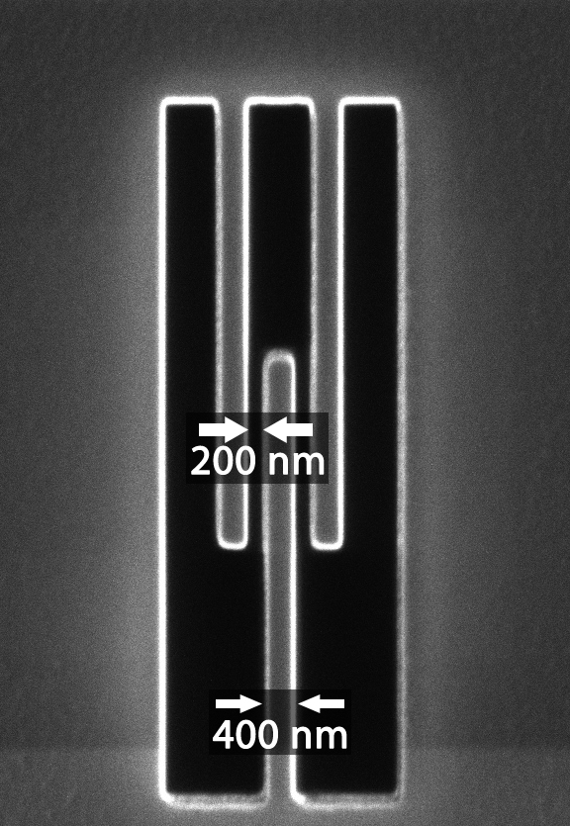
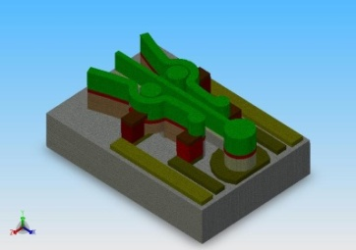
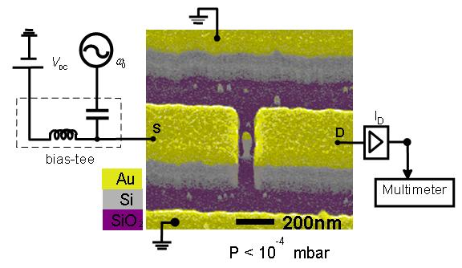
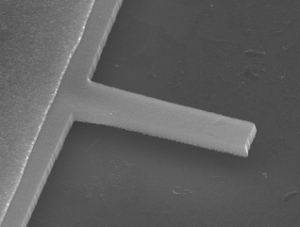
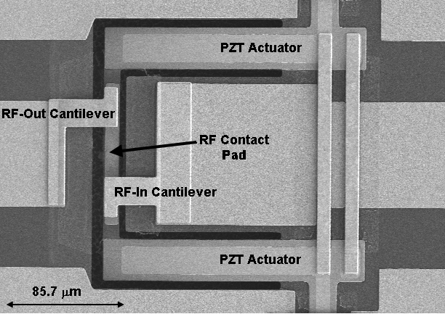
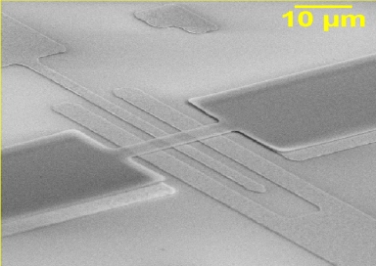
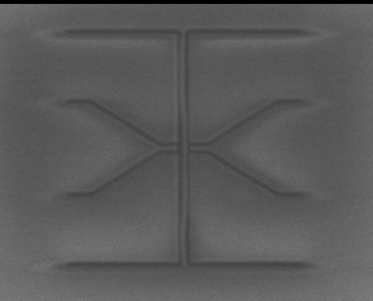
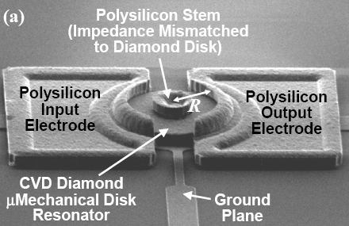
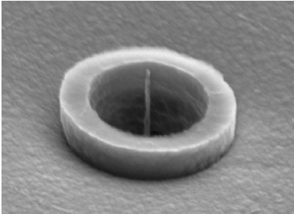
NanoElectroMechanical Switches (NEMS)
GE
Block MEMS
Berkeley
Wisconsin
Performers
Description
Case Western
Argonne
Diamond/PZT
ARL
PZT/Si Piezoelectric
CalTech
UC Berkeley
Isolated CMOS Gate
Block MEMS
Multilayer Switch
Signal electrode
W bridge
CalTech
SOI Switch/GaAs Piezo Switch
ARL
Case Western
SiC Switch for High T
Actuation electrode
Colorado
ALD ES Switch
Colorado
General Electric
Nanorod Vertical Switch
Minnesota
Self-assembled Composite Cantilever Gate
MIT
CNT vertical Switch
Sandia
ALD-deposited High T Material
Sandia
Stanford
Lateral ES Switch
Stanford
Wisconsin
Mechanical Motion-based Tunneling
Berkeley
Argonne
Minnesota
MIT

Slide 10
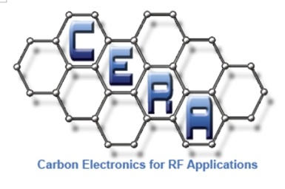
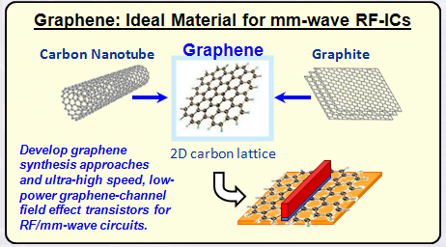
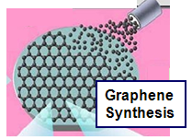
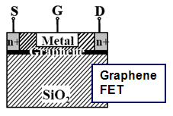
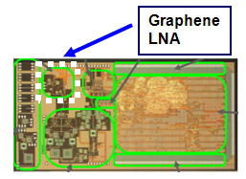
Carbon Electronics for RF
Applications (CERA)
GOALs: Develop wafer-scale epitaxial graphene synthesis techniques. Engineer graphene channel RF-transistors and exploit in RF circuits such as low noise amplifiers
APPROACH: SiC & SiGeC sublimation, CVD, MBE, Nickel catalyzed epitaxy, chemical methods
Performers: IBM, HRL, UCLA
CHALLENGES:
High quality graphene epitaxy
Properly designed G-channel RF-FETs
Si-compatible process flow
Low power high
performance LNAs

Slide 11

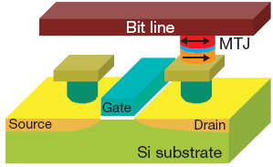
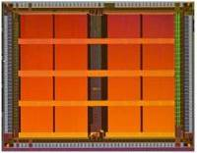

STT-RAM
PM: Dr. Devanand Shenoy
Exploit Spin Torque Transfer (STT) for switching nanomagnet orientation to create a non-volatile magnetic memory structure with power requirements 100x lower than SRAM and DRAM, and 100,000x lower than Flash memories
Spin Torque Transfer:
A current spin polarized, by passing through a pinned layer, torques the magnetic moments of the Free layer and switches a memory bit
 | Program Goal
Write Energy | 0.06 pJ/bit
Write/Read Speed | 5 ns/bit
Cell Area | 0.12 µm²
Thermal stability | 80
Endurance | 3X10¹⁶ (cycles)
 | 1 MB memory
MTJ
I_{c0}
Universal non-volatile magnetic memory with all the advantages and none of the drawbacks of conventional semiconductor memories
UCLA

Slide 12

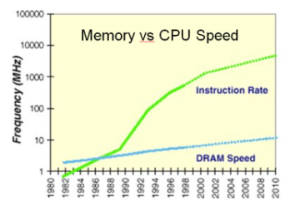
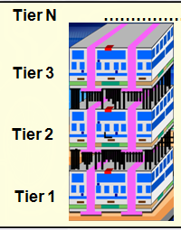
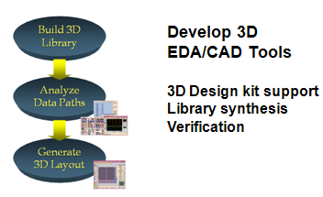
3-Dimensional Integrated
Circuits (3DIC)
Performers: ISC, IBM,
Stanford, PTC
Tezzaron (seedling)
Goal:
Develop 3DIC fabrication technologies and CAD tools enabling high density vertical interconnections
Methods:
3D packaging stacks, wafer-to-wafer bonding, monolithic 3D growth, 3D via technology, CAD tool development
Impact:
3D technologies enable novel architectures with high bandwidth and low latency for improved digital performance and lower power
3D Process
3D CAD
“HiBESST”
Explore limits of electronic BW
for high speed communication
Compelling 3DIC Demo
3D FPGA Design & Demos

Slide 13
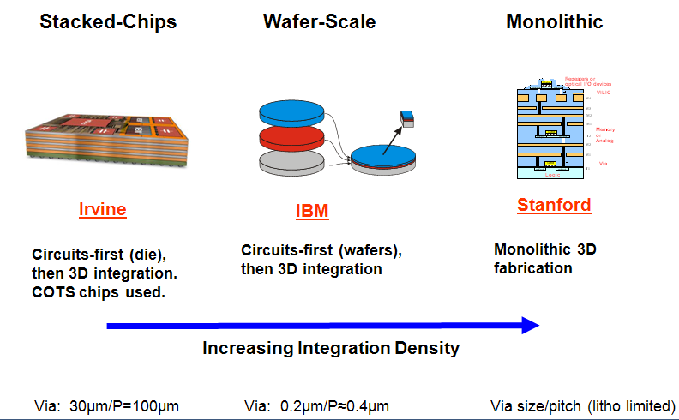
3DIC Program

Slide 14
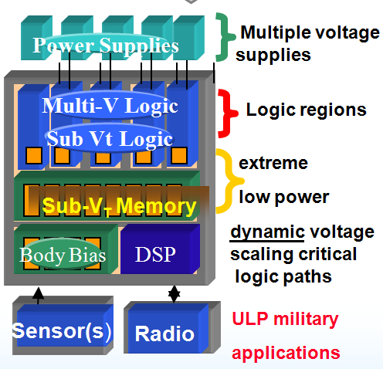
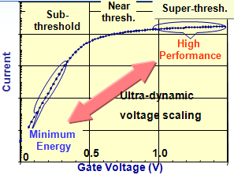
Ultra-low Power Sub-V_{T} Circuits
Goal: Enable dynamic voltage scaling leveraging sub-threshold operation regime.
Realize minimal performance impact
Challenges: VARIABILITY !
High efficiency low voltage distribution,
Domain granularity, Dynamic voltage/V_{t}scaling,
Automated CAD tools
Performers: MIT, Purdue, U. Ark,
UVA, Boeing (seedlings)
IMPACT: Substantial power reduction for key DoD digital computation needs without the need for a novel device technology

Slide 15

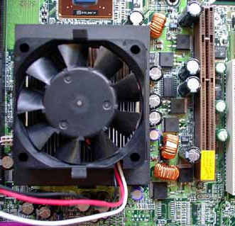
Microelectronics Packaging Today
Best modern technology in the electronics layer
Ancient “technology” in the thermal layer !
(side view)
fan
fin array heat sink
copper
chip
chip carrier

Slide 16
Thermal Resistance Breakdown
Where is the Problem?
Si chip
chip carrier
T_{Junction}
TIM
Heat spreader
T_{Junction}
Heat sink
T_{TIM}
Large ΔT’s spread throughout path from: Source → Sink
NO SINGLE CULPRIT
T_{Spreader}
Temperature
T_{HeatSink}
T_{Ambient}
R_{Substrate}
R_{Grease}
R_{Spreader}
R_{Heat Sink}
Power ~ NCV²F
Location

Slide 17
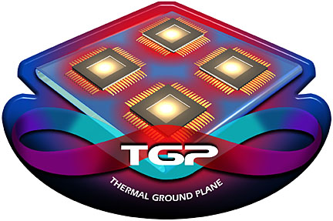
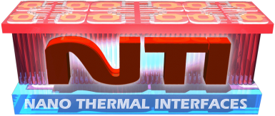

Thermal Management Portfolio
Si chip
chip carrier
NTI
chip carrier
TGP
MACE
T_{Junction}
T_{Junction}
Temperature
T_{TIM}
T_{Spreader}
T_{HeatSink}
T_{Ambient}
R_{NTI}
R_{TGP}
R_{MACE}
Power ~ NCV²F
Location

Slide 18

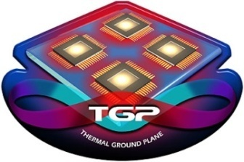

Technologies for Heat Removal from Electronics at the Device Scale (THREADS)
epi
“THREADs”
TIM
heat spreader
Reduce device-to-substrate thermal resistance
heat sink
T_{Junction}
Current MTO Programs
Temperature
T_{THREADS}
T_{TIM}
T_{Spreader}
T_{HeatSink}
T_{Ambient}
R_{epi}
R_{NTI}
R_{TGP}
R_{MACE}
Power
Location

Slide 19
Exascale Computing Study
What is Needed to Develop Future ExtremeScale Processing Systems ?
Four major challenges identified:
Energy Challenge: Driving the overall system energy low enough so that, when run at the desired computational rates, the entire system can fit within acceptable power budgets.
Parallelism/Concurrency Challenge: Provide the application developer with an execution and programming model that isolates the developer from the “burden” of massive parallelism
Storage Challenge: Develop memory architectures that provide sufficiently low latency, high bandwidth, and high storage capacity, while minimizing power via efficient data movement and placement
Resiliency Challenge: Achieving a high enough resiliency to both permanent and transient faults and failures so that an application can “work through” these problems.
NOTE: Power Efficiency is a Major Challenge !

Slide 20
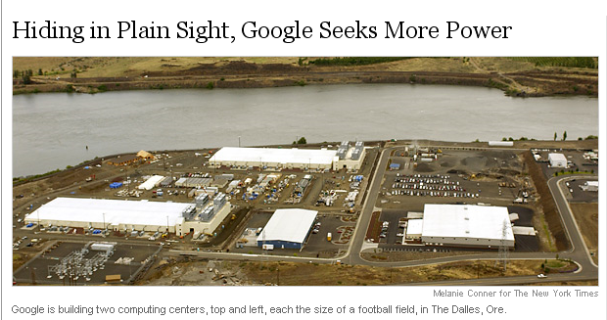
Power For Server Farms

Slide 21
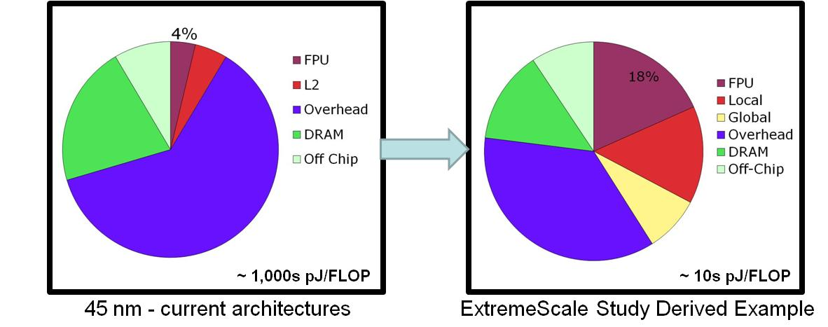
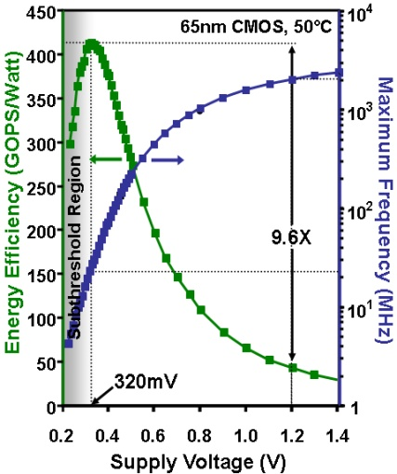
Processor Power Efficiency
Energy per operation is an overriding challenge
  DATA CENTERS: 1 ExaOPS at 1,000 pJ/OP => GW
    Cost of power: $1M per MegaWatt per year => $1B per year for power alone
  EMBEDDED applications: TeraOPS at 1,000 pJ/OP => KWs
Unacceptable
Power Req. !
“Strawman” processor architecture
  Develop processor design methodology using aggressive architectural techniques, aggressive voltage scaling, and optimized data placement and movement approaches to achieve 10s pJ/flop
  Requires integrated optimization of computation, communication, data storage, and concurrency
Optimize energy efficiency
Computing Must Be Reinvented For Energy Efficiency

Slide 22
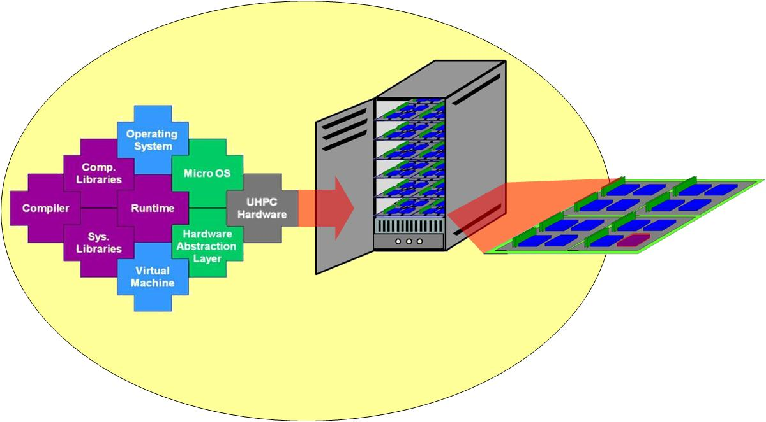
Proposed UHPC Program
Goal: Develop 1 PFLOPS single cabinet to 10 TFLOPS embedded module air-cooled systems that overcome energy efficiency and programmability challenges.
New system-wide technology approaches to maximize energy efficiency, with a 50 Gigaflops per watt goal, by employing hardware and software techniques for ultra-high performance DoD applications - efficiency.
Develop new technologies that do not require application programmers to manage the complexity, in terms of architectural attributes with respect to data locality and concurrency, of the system to achieve their performance and time to solution goals - programmability.
Develop solutions to expose and manage hardware and software concurrency, minimizing overhead for thousand- to billion-way parallelism for the system-level programmer.
Develop a system-wide approach to achieve reliability and security through fault management techniques enabling an application to execute through failures and attacks.
Execution Model
UHPC Specifications
1 PFLOPS
50 GFlops/W
Single Air-Cooled Cabinet
10 PB storage
1 PB memory
20 – 30 KW
Streaming I/O
Processor Module
Processor resources & DRAM
10 TFLOPS
32 GB
125 W
1 Byte/FLOP off-chip Bandwidth
Reinventing Computing
For Power Efficiency

Slide 23
We’re Always Hiring at DARPA
DARPA PM Candidate Characteristics
Idea Generator
Technical Expert
Entrepreneur
Passion to Drive Leading Edge Technology
National Service
DARPA Hires Program Managers for their Program Ideas
… do you have what it takes?
… come talk to us.

